Slide 1
Interpolation 1: Polynomial Interpolation
AMSC/CMSC 460
Dr. Christopher Moakler

Slide 2
Review from last time
We looked more in-depth into the Normal Equations and how to use them to find the Least Squares solution to an inconsistent system.
The normal equations are,
$$A^{T}A\overline{x}=A^{T}b$$
The solution to this system of equations minimizes the Square Error.
The Square Error is defined by way of the residual,
$$r=b−A\overline{x}$$
There were three different measures of the residual that we looked at:
${\left|\left|r\right|\right|}_{2}=\sqrt{r_{1}^{2}+r_{2}^{2}+…+r_{m}^{2}}$
Squared Error = ${\left|\left|r\right|\right|}_{2}^{2}=r_{1}^{2}+r_{2}^{2}+…+r_{m}^{2}$
RMS Error $=\sqrt{\frac{Squared Error}{m}}=\frac{{\left|\left|r\right|\right|}_{2}}{\sqrt{m}}$

Slide 3
Review from last time cont
We also looked at applying the method of Least Squares to fit a model to data.
This can be applied to an arbitrary set of data.
The main idea is to find some model that you think fits your data; linear, exponential, power, sinusoidal, etc., and use it to form a set of linear equations.
This system is then solved using the Normal Equations.
Any model can be used as long as the coefficients of the model appear linearly.
The last thing we looked at was using QR decomposition to find the least squares solution and using Householder reflectors to find the QR decomposition
Notes:
We also had what, I think, was a really interesting discussion about how we do data analysis!

Slide 4
https://xkcd.com/2582/

Slide 5
https://commons.wikimedia.org/wiki/File:16,_Stationsstraat,_Maastricht.jpg
https://commons.wikimedia.org/wiki/File:BMW_tire.jpg

Slide 6
What is interpolation?
Interpolation is used to find a function connecting arbitrary points.

Slide 7
Interpolation vs. Extrapolation
Interpolation is used to find approximate values of a function between interpolating points.
Extrapolation is used to find approximate function values at points outside of your data.

Slide 8
Interpolation vs. Extrapolation vs. Regression
Interpolation finds a function that fits data points to find intermediate values.
You have function values on a grid but want to approximate a value between the grid points.
Extrapolation uses a function to make predictions about what the data will do beyond the known points.
You have function values in a region but want to approximate the function beyond that region.
Regression tries to find the underlying relationship that dictates the data.
You have data and want to find the physical law that describes the phenomenon that you measured your data from.

Slide 9
Interpolation Graphical Example
Sauer

Slide 10
Interpolation
A function, $f\left(x\right),$ is said to interpolate data points $\left(x_{1},y_{1}\right), \left(x_{2},y_{2}\right), …,\left(x_{n},y_{n}\right)$ if $f\left(x_{i}\right)=y_{i} ∀i$
The function, $f(x)$, must actually be a function!
That is, every x-value can only correspond to one y-value.
The simplest class of functions which we can use to find an interpolating function are the polynomials.
Why do we use polynomials?

Slide 11
Polynomial Interpolation
We use polynomials for interpolation for several reasons.
Firstly, we are guaranteed to have a polynomial interpolating function for any number of points, as long as the x-values are distinct.
This function will pass through every single point we wish it to.
Secondly, we have dedicated hardware and software that can multiply and add numbers very very quickly.
Of particular importance is the Multiply–accumulate operation also known as fused multiply-add.
This performs a combined multiplication and addition, $a=a+(b×c)$.
It does this while doing only one rounding.
It can be used in several different applications including evaluating polynomials via Horner’s Method.

Slide 12
Polynomial Interpolation cont
Horner’s Rule states,
$$a_{0}+a_{1}x+a_{2}x^{2}+…+a_{n}x^{n}=a_{0}+x\left(a_{1}+x\left(a_{2}+x\left(a_{3}+…+x\left(a_{n−1}+xa_{n}\right)…\right)\right)\right)$$
We looked at this particular method of polynomial evaluation earlier in the class.
This requires only $n$ multiplications and $n$ additions.
It is an optimal method.
This is useful because we can approximate an arbitrary function, say a sine wave, with a polynomial.
We can then calculate approximate sine values using only addition and multiplication.

Slide 13
Lagrange Interpolation Example 1
If we are given $n$ data points, we can form a polynomial of degree $n−1$ using the Lagrange interpolating formula.
Say we have three data points; $\left(x_{1},y_{1}\right), \left(x_{2},y_{2}\right),$ and $\left(x_{3},y_{3}\right)$, the Lagrange interpolating polynomial is,
$$P_{2}\left(x\right)=y_{1}\frac{(x−x_{2})(x−x_{3})}{(x_{1}−x_{2})(x_{1}−x_{3})}+y_{2}\frac{(x−x_{1})(x−x_{3})}{(x_{2}−x_{1})(x_{2}−x_{3})}+y_{3}\frac{(x−x_{1})(x−x_{2})}{(x_{3}−x_{1})(x_{3}−x_{2})}$$
What is the value of $P_{2}\left(x\right)$ at each of the known data points.
This is why we constructed the polynomial in the first place!

Slide 14
Lagrange Interpolation Example 2
Find the Lagrange Interpolating Polynomial for the points $\left(0,1\right), \left(2,2\right),$ and $\left(3,4\right).$
Let’s plug into the polynomial from before,
$$P_{2}\left(x\right)=1\frac{(x−2)(x−3)}{(0−2)(0−3)}+2\frac{(x−0)(x−3)}{(2−0)(2−3)}+4\frac{(x−0)(x−2)}{(3−0)(3−2)}$$
$$P_{2}\left(x\right)=\frac{1}{6}\left(x^{2}−5x+6\right)+2\left(−\frac{1}{2}\right)\left(x^{2}−3x\right)+4\left(\frac{1}{3}\right)\left(x^{2}−2x\right)$$
$$P_{2}\left(x\right)=\frac{1}{2}x^{2}−\frac{1}{2}x+1$$
We should ensure that $P_{2}\left(0\right)=1,P_{2}\left(2\right)=2,$ and $P_{2}\left(3\right)=4$.

Slide 15
Lagrange Interpolating Polynomial
To generalize this, we first define the polynomial,
$$L_{k}\left(x\right)= \frac{\left(x−x_{1}\right)…\left(x−x_{k−1}\right)\left(x−x_{k+1}\right)…(x−x_{n})}{\left(x_{k}−x_{1}\right)…\left(x_{k}−x_{k−1}\right)\left(x_{k}−x_{k+1}\right)…(x_{k}−x_{n})}$$
What does this evaluate to at the point $x_{k}$?
What about $x_{j}$ where $x_{j}$ is one of the other interpolating points?
That’s really convenient for us!
Now we find the full interpolating polynomial by forming the degree $n−1$ polynomial
$P_{n−1}\left(x\right)=y_{1}L_{1}\left(x\right)+ …+y_{n}L_{n}(x)$.
What does this evaluate to at each of the interpolating points?

Slide 16
Main Theorem of Polynomial Interpolation
We have found a polynomial whose degree is at most $n−1$ and goes through the $n$ data points.
This is the only polynomial with those two properties.
Theorem: For any collection of $n$ data points $\left(x_{1},y_{1}\right),…,(x_{n},y_{n})$ with distinct $x_{i}^{′}s$, there exists only one polynomial of degree $n−1$, or less, that passes through all $n$ data points.
Proof: Suppose not. If there are two such polynomials, $P$ and $Q$, that have degree at most $n−1$ and pass through all points. That is $P\left(x_{1}\right)=Q\left(x_{1}\right),…, and P\left(x_{n}\right)=Q\left(x_{n}\right)$.
Define a new polynomial $H\left(x\right)=P\left(x\right)−Q(x)$. At every point $H\left(x_{1}\right)=…=H\left(x_{n}\right)=0$.
However, according to the Fundamental Theorem of Algebra, a polynomial of degree $d$ can have at most $d$ zeroes unless it is identical to the zero polynomial.
Thus $P\left(x\right)=Q\left(x\right)$

Slide 17
Lagrange Interpolation Example 3
Find the polynomial of degree 3 or less that passes through the points $\left(0,2\right), \left(1,1\right), (2,0)$ and $\left(3,−1\right).$
We form the Lagrange Polynomial as before,
$P_{3}\left(x\right)=2\frac{(x−1)(x−2)(x−3)}{(0−1)(0−2)(0−3)}+1\frac{(x−0)(x−2)(x−3)}{(1−0)(1−2)(1−3)}+0\frac{(x−0)(x−1)(x−3)}{(2−0)(2−1)(2−3)}−1\frac{(x−0)(x−1)(x−2) }{(3−0)(3−1)(3−2)}$.
$$P_{3}\left(x\right)=−\frac{1}{3}\left(x^{3}−6x^{2}+11x−6\right)+\frac{1}{2}\left(x^{3}−5x^{2}+6x\right)−\frac{1}{6}\left(x^{3}−3x^{2}+2x\right)$$
$P_{3}\left(x\right)=−x+2$

Slide 18
Lagrange Interpolation Example 3 cont
The theorem states that a polynomial of degree at most $n−1$ exists.
That does not mean the polynomial must be degree $n−1$.
Since the polynomial is unique, we can also say that there does not exist polynomials of order 2 or 3 that pass through the points.
For example, there is no parabola or cubic curve that passes through four points in a line.

Slide 19
Shortcomings of Lagrange Interpolation
The Lagrange interpolating polynomial is very awkwardly constructed.
We have to form multiple high order polynomials that are subject to floating point issues.
To actually use these functions to compute values can be very costly because they are not in a convenient form.
It would be much better if we could have the polynomial in the form from Horner’s Rule.

Slide 20
Newton’s Divided Difference Formula
A more convenient method of forming the interpolating polynomial is to use Newton’s Divided Difference Formula.
First, we need some definitions.
The 0th divided difference is denoted by,
$f\left[x_{i}\right]=f(x_{i})$.
The 1st divided difference is denoted by,
$$f\left[x_{i},x_{i+1}\right]=\frac{f\left[x_{i+1}\right]−f\left[x_{i}\right]}{x_{i+1}−x_{i}}.$$
The 2nd divided difference is denoted by,
$$f\left[x_{i},x_{i+1},x_{i+2}\right]=\frac{f\left[x_{i+1},x_{i+2}\right]−f\left[x_{i},x_{i+1}\right]}{x_{i+2}−x_{i}}.$$
The k-1st divided difference is denoted by,
$$f\left[x_{i},x_{i+k}\right]=\frac{f\left[x_{i+1},…,x_{i+k}\right]−f\left[x_{i},{…,x}_{i+k−1}\right]}{x_{i+k}−x_{i}}.$$

Slide 21
Divided Differences Example
It is easy to calculate these in a tabular form
x | f(x) | 1st Divided Difference | 2nd Divided Difference | 3rd Divided Difference
0 | 3
1 | 4
2 | 7
4 | 19

Slide 22
Divided Differences Example
It is easy to calculate these in a tabular form
x | f(x) | 1st Divided Difference | 2nd Divided Difference | 3rd Divided Difference
0 | 3
1 | 4 | 1
2 | 7 | 3
4 | 19 | 6

Slide 23
Divided Differences Example
It is easy to calculate these in a tabular form
x | f(x) | 1st Divided Difference | 2nd Divided Difference | 3rd Divided Difference
0 | 3
1 | 4 | 1
2 | 7 | 3 | 1
4 | 19 | 6 | 1 | 0

Slide 24
Newton’s Divided Difference Formula cont
Newton’s Divided Difference formula allows us to form the interpolating polynomial using these divided differences.
The polynomial is
$$P_{n}\left(x\right)=f\left[x_{1}\right]+$$
$f\left[x_{0},x_{1}\right]\left(x−x_{0}\right)+$
$f\left[x_{0},x_{1},x_{2}\right]\left(x−x_{0}\right)\left(x−x_{1}\right)+…+$
$f\left[x_{0},…x_{n}\right]\left(x−x_{0}\right)…(x−x_{n−1})$

Slide 25
Newton’s Divided Difference Formula Example
Find the interpolating polynomial passing through the points $\left(0,1\right), \left(2,2\right),$ and $(3,4)$.
x | f(x) | 1st DD | 2nd DD
0 | 1
2 | 2
3 | 4

Slide 26
Newton’s Divided Difference Formula Example
Find the interpolating polynomial passing through the points $\left(0,1\right), \left(2,2\right),$ and $(3,4)$.
x | f(x) | 1st DD | 2nd DD
0 | 1
2 | 2 | ½
3 | 4 | 2 | ½

Slide 27
Newton’s Divided Difference Formula Example
x | f(x) | 1st DD | 2nd DD
0 | 1
2 | 2 | ½
3 | 4 | 2 | ½
Now we can form the polynomial.
The coefficients we need are on the diagonal.
$$P_{2}\left(x\right)=1+\frac{1}{2}\left(x−0\right)+\frac{1}{2}\left(x−0\right)\left(x−2\right)$$
This is very easy to put into the nested form
$P_{2}\left(x\right)=1+\left(x−0\right)(\frac{1}{2}+\frac{1}{2}\left(x−2\right))$.
Or we can expand it out
$$P_{2}\left(x\right)=1+\frac{1}{2}\left(x−0\right)+\frac{1}{2}\left(x−0\right)\left(x−2\right)=1+\frac{1}{2}x+\frac{1}{2}x^{2}$$
Which is exactly what we got when we used Lagrange Interpolation.

Slide 28
Newton’s Divided Difference Formula Example Part 2
Another useful feature of Newton’s Divided Difference Formula is that if we want to add another point to our interpolation, we do not need to throw out all the previous work we did.
If we wanted to add another point while using Lagrange's approach, we would need to do everything over again.
Say we want to find the interpolating polynomial passing through the points $\left(0,1\right), \left(2,2\right),\left(3,4\right),$ and $(1,0)$.
We find the divided differences as before
and we can keep most of the work we
already did!
x | f(x) | 1st DD | 2nd DD | 3rd DD
0 | 1
2 | 2 | ½
3 | 4 | 2 | ½
1 | 0 | 2 | 0 | -½

Slide 29
Newton’s Divided Difference Formula Example Part 2 cont
The polynomial is,
$P_{3}\left(x\right)=1+\frac{1}{2}\left(x−0\right)+\frac{1}{2}\left(x−0\right)\left(x−2\right)−\frac{1}{2}(x−0)(x−2)(x−3)$.
We can even reuse part of the previous polynomial!
Note that,
$P_{3}\left(x\right)=P_{2}−\frac{1}{2}(x−0)(x−2)(x−3)$.
This benefit should not be overlooked!
If we get new data, we can VERY quickly update
our interpolating polynomial.
x | f(x) | 1st DD | 2nd DD | 3rd DD
0 | 1
2 | 2 | ½
3 | 4 | 2 | ½
1 | 0 | 2 | 0 | -½

Slide 30
How many interpolating polynomials are there?
For an arbitrary set of $n$ data points, how many degree $n$ polynomials are there?
Think about the previous example as a hint. What did we do to the first polynomial based on 3 data points to get the polynomial based on 4?
In the previous example, we could have chosen any $x_{4}$ that wasn’t degenerate and we could have then chosen from an infinite number of $y_{4}^{′}s$.
The polynomial resulting from that 4th data point must be unique for each choice!
And, the polynomial also still goes through the original points!
There are infinitely many interpolating polynomials of degree $n$ going through $n$ points.

Slide 31
Function Approximation using interpolation
A common application of interpolation is to simplify the computation of complex functions.
If we can find a polynomial that approximates a function “good enough” we can use that to see some computational speed ups.
For example, if we wanted to find an interpolating polynomial to approximate the sine function, we can take a collection of data points we know lie on the function.
For the sine function we can restrict ourselves to the interval $[0,\frac{π}{2}]$ and use trig identities to calculate any other value we want.
We can then pick, say, 4 equally spaced points on this interval and find a 3rd order polynomial that interpolate the function.

Slide 32
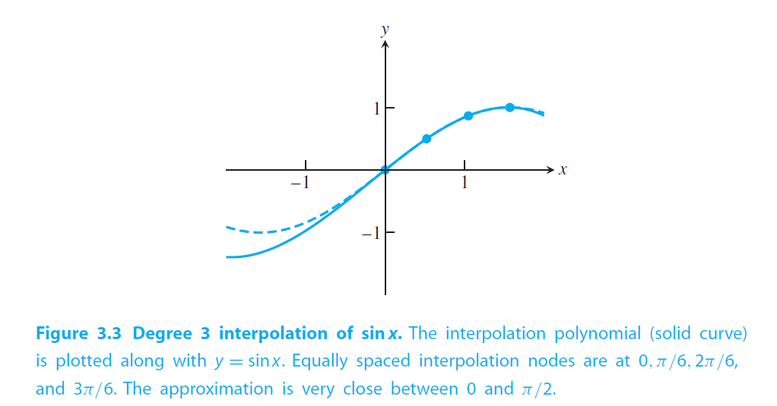
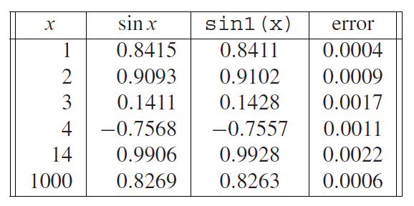
Function Approximation using interpolation cont
We can then pick, say, 4 equally spaced points on this interval and find a 3rd order polynomial that interpolate the function.
This function won’t be exact, but it might work well enough!
Sauer
Sauer

